Slide 1
Simple Linear Regression
“No free lunch in statistics: no one method dominates all others over all possible datasets”

Slide 2
Types of Linear Regression
Linear regression analysis is a predictive modelling technique used for building mathematical and statistical models that characterize relationships between a dependent (continuous) variable and one or more independent, or explanatory variables (continuous or categorical), all of which are numerical.
This technique is useful in forecasting, time series modelling, and finding the causal effect between variables.
Simple linear regression involves one independent variable and one dependent variable.
Independent variable: The variable used to explain the dependent variable, usually denoted by X. Also known as a predictor variable.
Dependent variable: The variable we wish to explain, usually denoted by Y. Also known as an outcome variable.
Multiple linear regression involves two or more independent variables and one dependent variable.
Regression modeling means not only estimating the coefficients but also choosing which predictors to include and in what form.
We can calculate the MSE for Linear Regression Models as well as other types of models.

Slide 3
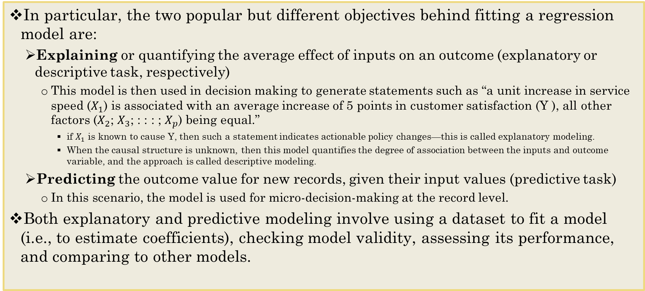
Usefulness of Regression Models
In particular, the two popular but different objectives behind fitting a regression model are:
Explaining or quantifying the average effect of inputs on an outcome (explanatory or descriptive task, respectively)
This model is then used in decision making to generate statements such as “a unit increase in service speed ($X_{1}$) is associated with an average increase of 5 points in customer satisfaction (Y ), all other factors ($X_{2}$; $X_{3}$; : : : ; $X_{p}$) being equal.”
if $X_{1}$ is known to cause Y, then such a statement indicates actionable policy changes—this is called explanatory modeling.
When the causal structure is unknown, then this model quantifies the degree of association between the inputs and outcome variable, and the approach is called descriptive modeling.
Predicting the outcome value for new records, given their input values (predictive task)
In this scenario, the model is used for micro-decision-making at the record level.
Both explanatory and predictive modeling involve using a dataset to fit a model (i.e., to estimate coefficients), checking model validity, assessing its performance, and comparing to other models.

Slide 4
Prediction and Causal Analysis
Correlation r: An association or more precisely a measure of the extent to which two variables are related.
Causation: the demonstration of how one variable influences another variable or other variables.
A statistical significant relationship from a Regression does not necessarily indicate causality.
What do we need to determine causation?
Significant Correlation: Statistically significant relationship between the variables.
Temporal Precedence: Causal variable occurred prior to the other variable.
Eliminate Alternate Variables: No other factors can account for the cause.

Slide 5
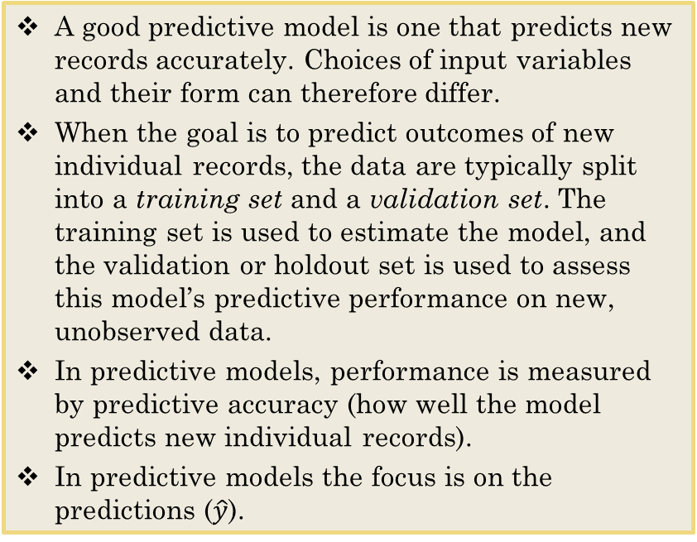
Differences Between 2 types of Regression Models
A good predictive model can have a looser fit to the data on which it is based, and a good explanatory model can have low prediction accuracy.
A good explanatory model is one that fits the data closely.
In explanatory models, the entire dataset is used for estimating the best fit model, to maximize the amount of information that we have about the hypothesized relationship in the population.
Performance measures for explanatory models measure how close the data fit the model (how well the model approximates the data) and how strong the average relationship is.
In explanatory models the focus is on the coefficients (β).
A good predictive model is one that predicts new records accurately. Choices of input variables and their form can therefore differ.
When the goal is to predict outcomes of new individual records, the data are typically split into a training set and a validation set. The training set is used to estimate the model, and the validation or holdout set is used to assess this model’s predictive performance on new, unobserved data.
In predictive models, performance is measured by predictive accuracy (how well the model predicts new individual records).
In predictive models the focus is on the predictions ($\hat{y}$).
Notes:
Explanatory model (R^2)vs predictive model (predictive function to calculate the accuracy, i.e. min error)

Slide 6

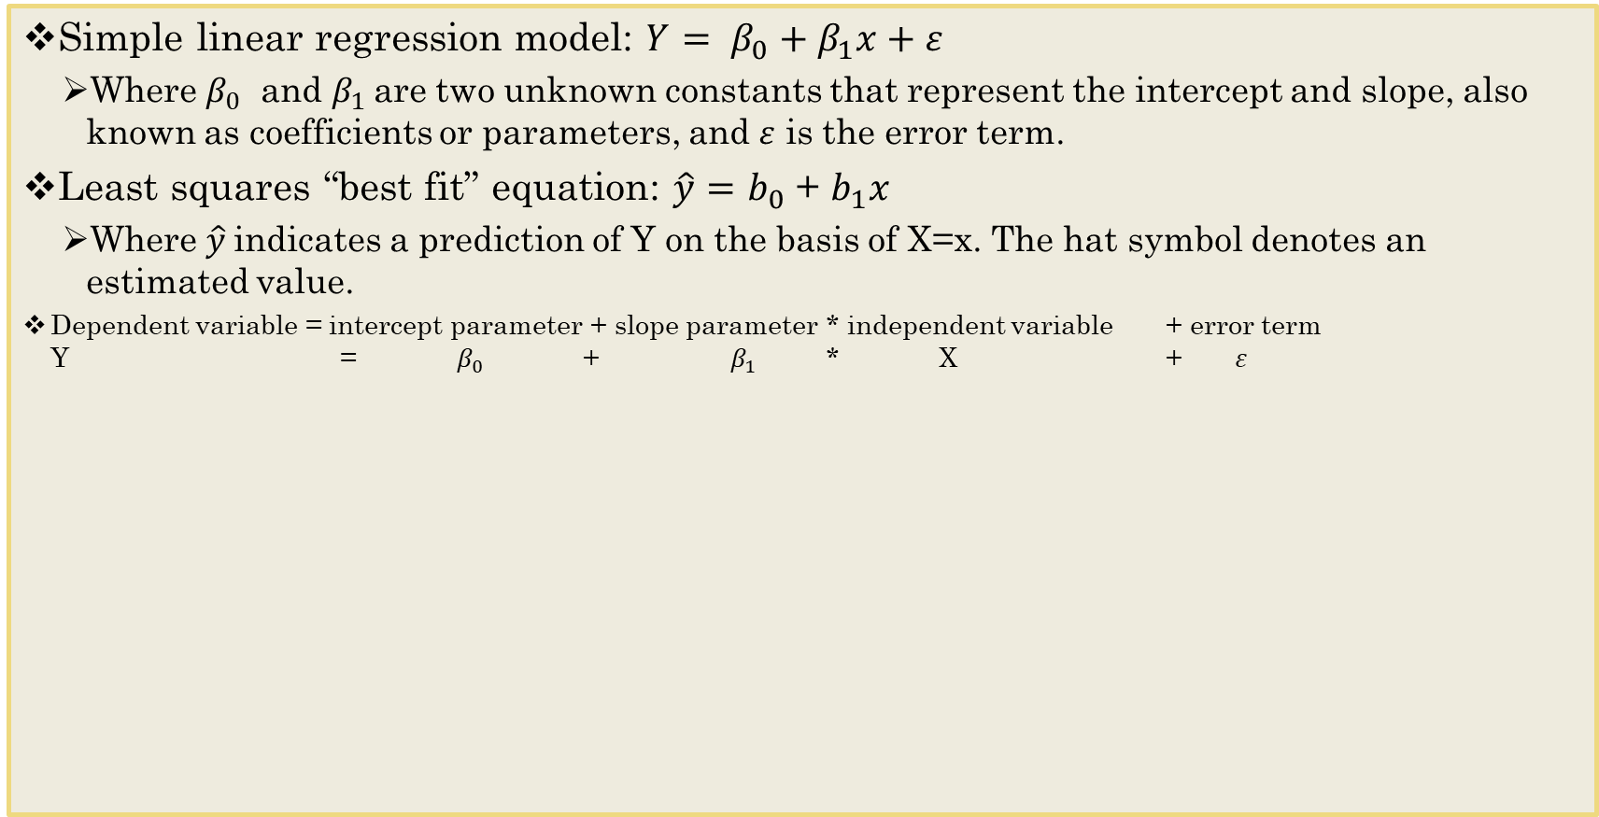

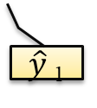
Estimating the Regression Equation
Simple linear regression model: ${Y= β}_{0}+β_{1}x+ε$
Where $β_{0}$ and $β_{1}$are two unknown constants that represent the intercept and slope, also known as coefficients or parameters, and $ε$ is the error term.
Least squares “best fit” equation: $\hat{y}=$ $b_{0}$ + $b_{1}x$
Where $\hat{y}$indicates a prediction of Y on the basis of X=x. The hat symbol denotes an estimated value.
Dependent variable = intercept parameter + slope parameter * independent variable + error term Y = ${ β}_{0}$ + $β_{1}$ * X + $ε$
Dependent Variable (Y)
Y₁
$ε$₁
$β$₁ units
$\hat{y}$₁
Independent Variable (X)

Slide 7
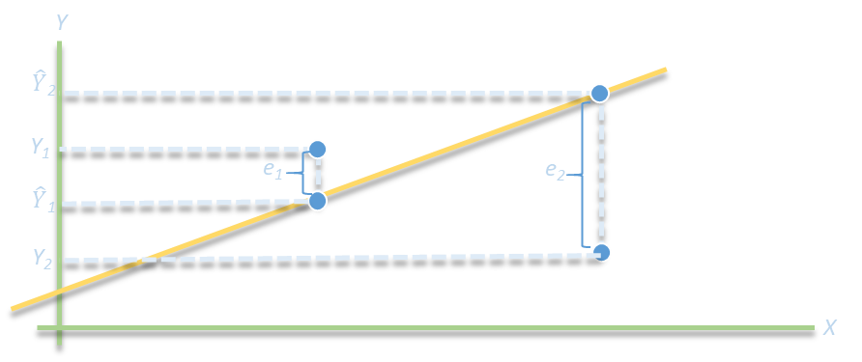
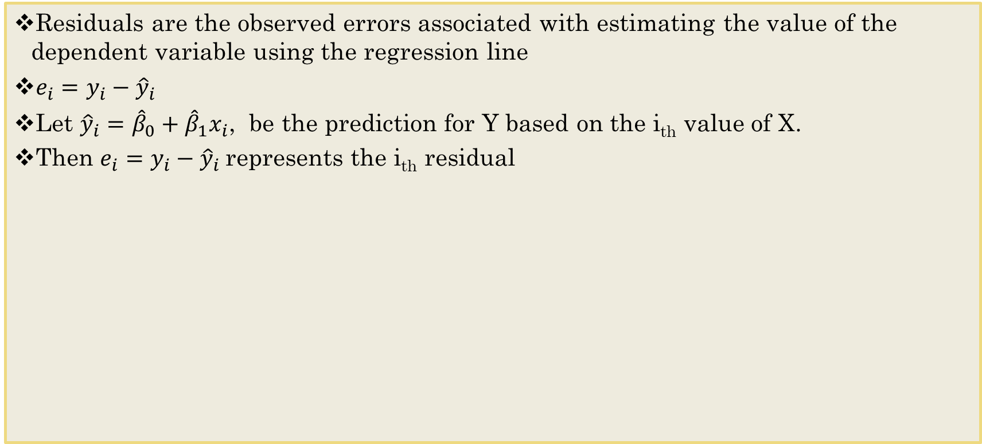
Residuals
Residuals are the observed errors associated with estimating the value of the dependent variable using the regression line
$e_{i}=y_{i}−{\hat{y}}_{i}$
Let ${\hat{y}}_{i}={\hat{β}}_{0}+{\hat{β}}_{1}x_{i}$, be the prediction for Y based on the i_{th} value of X.
Then $e_{i}=y_{i}−{\hat{y}}_{i}$represents the i_{th} residual
Notes:
Error: inner regression error

Slide 8
Regression as Analysis of Variance
ANOVA conducts an F - test to determine whether variation in Y is due to varying levels of X.
ANOVA is used to test for significance of regression:
H₀: population slope coefficient = 0
H₁: population slope coefficient ≠ 0
R reports the p-value (Significance F).
Rejecting H₀ indicates that X explains variation in Y

Slide 9
Some Regression Statistics
Multiple R or | r |, where r is the sample correlation coefficient.
The value of r varies from -1 to +1.
r is negative if slope is negative.
Coefficient of determination R² = 1 – (SS _{Regression} / SS _{Total})
Multiple R-squared (R²) is a measure of the “fit” of the line to the data.
The value of R² will be between 0 and 1; A value close to 0.0 indicates that the data set is not explained by a linear model.
The larger the value of R² the better the fit.
A value of 1.0 indicates a perfect fit and all data points would lie on the line.
Where SS Regression is the sum of squares regression error and SS Total is the sum of squares total error
Adjusted R Squared - adjusts R² for sample size and number of X variables.
Residual Standard Error (RSE) - variability between observed and predicted Y values, or the estimate of the deviation of error.
Notes:
Adjusted R^2: Sample size affects accuracy

Slide 10
Bias and Predictions
Predictions based on the regression equation are the best predictions possible in the sense that they will be unbiased (equal to the true values on average) and will have the smallest mean squared error compared to any unbiased estimates if we make the following assumptions:
The noise ϵ (or equivalently, Y ) follows a normal distribution.
The choice of predictors and their form is correct (linearity).
The records are independent of each other.
The variability in the outcome values for a given set of predictors is the same regardless of the values of the predictors (homoskedasticity).

Slide 11
Violating Assumptions
The assumption of a normal distribution is required in explanatory modeling, where it is used for constructing confidence intervals and statistical tests for the model parameters.
When we detect a relationship between 2 variables, we reduce uncertainty.
Uncertainty implies that there is a randomness to events or that events have random variability.
Relationships between variables are rarely perfect; however, the relationship is stronger if there is less random variability.
An important and interesting fact for the predictive goal is that even if we drop the first assumption and allow the noise to follow an arbitrary distribution, these estimates are very good for prediction, in the sense that among all linear models, as defined by the regression equation, the model using the least squares estimates, will have the smallest mean squared errors
Even if the other assumptions are violated, it is still possible that the resulting predictions are sufficiently accurate and precise for the purpose they are intended for.
The key is to evaluate predictive performance of the model, which is the main priority. Satisfying assumptions is of secondary interest and residual analysis can give clues to potential improved models to examine.

Slide 12
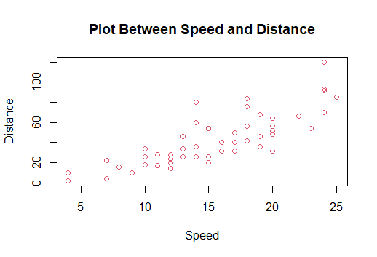
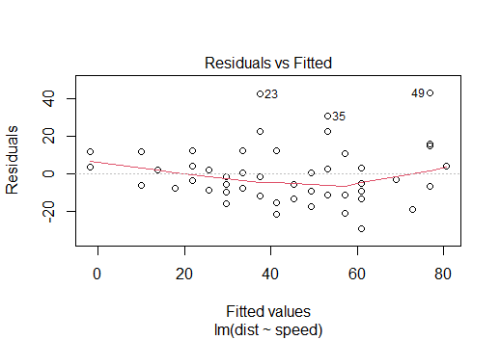
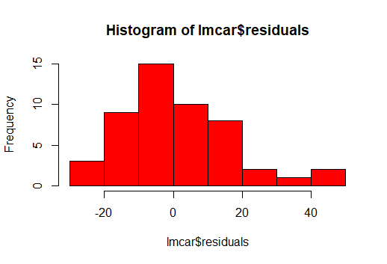
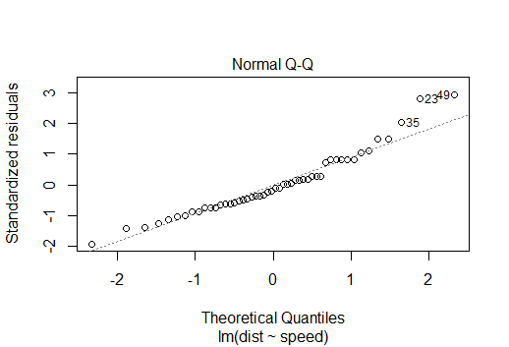
Checking Linear Assumptions
Linearity
examine scatter diagram (should appear linear)
examine residual plot (should appear random)
Normality of Errors
view a histogram of standard residuals
regression is robust to departures from normality
Independence of Errors: successive observations should not be related.
This is important when the independent variable is time.
Homoscedasticity: variation about the regression line is constant
examine the residual plot
Data appears linear and residual plot looks random. There is no obvious pattern to the residuals and there is equal spread around the horizontal line.
Residual histogram appears slightly skewed but is not a serious departure.
In the Q-Q Plot the residuals will follow close to a straight line on this plot, as an indicator that they are normally distributed
Because the data is cross-sectional, we can assume this assumption holds.
Residual plot shows no serious difference in the spread of the data for different X values.
Mean of residuals should be around 0

Slide 13
Steps in Simple Linear Regression: Explanatory Model
Import data and evaluate it using summary functions
Create a linear model using the lm() function
Prepare a scatter plot to verify the data has a linear trend.
Draw an abline through the scatter.
Define the linear relationship: positive or negative and determine the equation for the line
Check for assumptions.
See if small number of outliers, or if another alternative approaches is needed if the data is not linear.
Explain variability and adjust model if needed.
True regression functions are never perfectly linear, but linear regression is extremely useful both conceptually and practically.

Slide 14
The Validation Method for Predictive Modeling in Regression
First, the response and non-response data are separated into two distinct sets, or strata.
Records are then randomly selected for the training set from each stratum.
The remaining responders are put in the validation set.
Non-responders are randomly selected for the validation set in sufficient numbers to maintain the original ratio of responders to non-responders.
If a test set is required, it can be taken randomly from the validation set.
Run regression on training set.
Make predictions on test set using predict function
Check for accuracy – We will work through Cross-Validation in Chapter 5.

Slide 15
To Do
Work through Simple_Linear_Regression Swirl exercise.
Notes
Be sure to use TeamMates on Cases in future – Remember – I will not reopen them again.
I send the reminders through TeamMates.
I should have your grades for your first case study complete on Thursday.
For participation points: Only SAS approved accommodations are allowed with the exception of a University activity or a documented emergency situation beyond the student's control.

